Slide 1

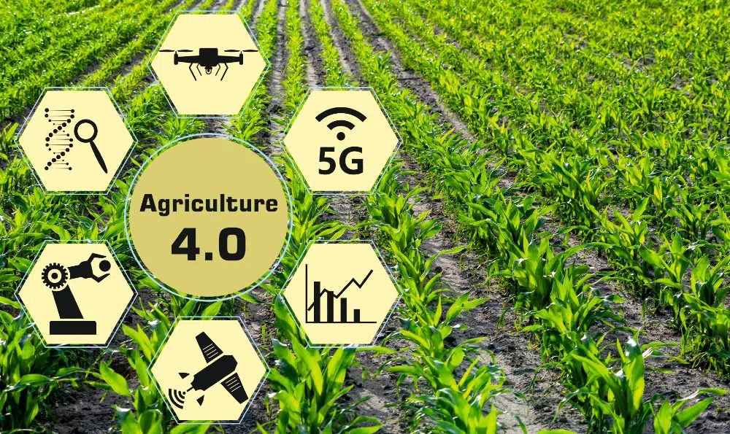

Anomaly Detection for
Agriculture 4.0
(DSCI 6002 – Intro to Data Science) Group 9: Sort Out

Slide 2





MEET THE TEAM
SELINAM SETRANAH
DEVNATH REDDY MOTATI
AJAY KUMAR JAGU
AVINASH REDDY BHAVANAM
KRISHNA SURENDRA PALEPU

Slide 3

INTRODUCTION
A number of global trends are influencing food security, poverty, and the overall sustainability of food and agricultural systems.
The World Government Summit launched a report called Agriculture 4.0 addressing the four main developments placing pressure on agriculture to meeting the demands of the future.
The report states that, although demand is continuously growing, by 2050 we will need to produce 70 percent more food.
Agriculture 4.0 tries to solve this problem with the help of IOT, IT and various technologies thereby increasing food production.

Slide 4
problem
As farming becomes more dependent on computer systems, and data from sensors and actuators, cybersecurity concerns are increasing
Sensors generate a large amount of data, which is then processed by the farm management system to take certain actions, so it is essential to ensure that the data coming in is not manipulated and anomalous.
Cyber-agro terrorists can compromise farm networks to inject false data and destroy crops and livestock, causing huge financial losses and creating social unrest.

Slide 5
Objectives
To detect anomalous data coming from sensors.
To alert the farmer of any anomalous data.
Prevent the Farm management system from malfunctioning due to inaccurate data.

Slide 6
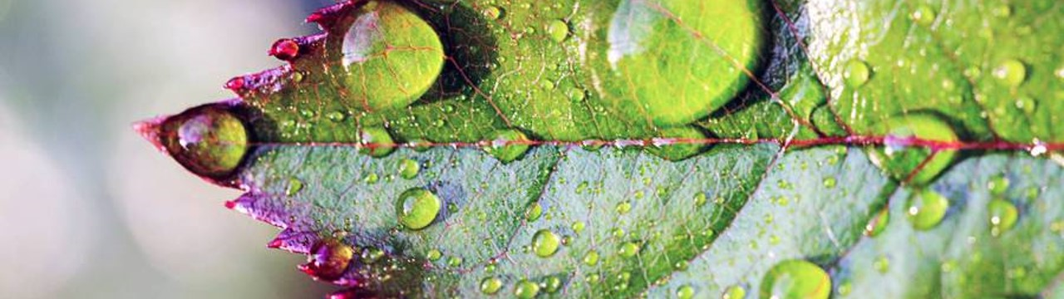
DATA SOURCE
Data will be collected using different sensors such as capacitive soil moisture sensor, DHT11 Humidity and Temperature sensor over a desired period of time.

Slide 7
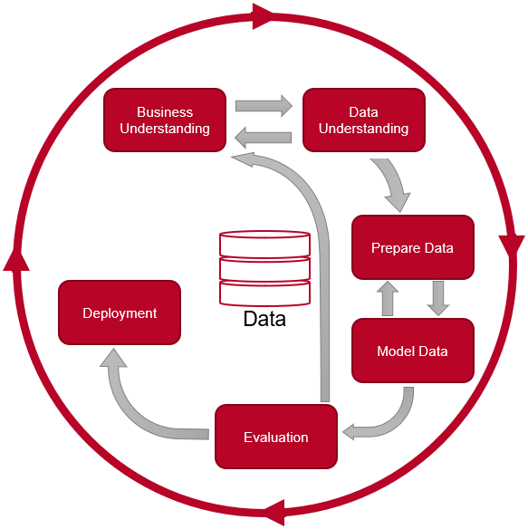
CRISP-DM

Slide 8
BUSINESS UNDERSTANDING
From the business perspective, having an anomaly detection for a farm management system would prevent it from malfunctioning and therefore destroying the crops.
For example: Suppose the data streamed from the soil moisture sensor says that the soil is dry(Anomalous data) but in reality, the soil is wet or has adequate moisture . The Farm Management System would operate the actuator for water to restore the moisture level and ultimately end up over irrigating and destroying the crops.

Slide 9
Data UNDERSTANDING
The data collected from various sensors will be :
Date and time
Soil moisture level
Ph level of the soil
Temperature
Humidity
Sensor ID

Slide 10
PROPOSED SYSTEM
For our anomaly detection system we will be using the Isolation Forest model to detect the anomalous data coming from the sensors such as Soil humidity, pH level of the soil, air and soil temperature and so on along with the time and sensor id.
Use an alerting system to alert the farmers.

Slide 11
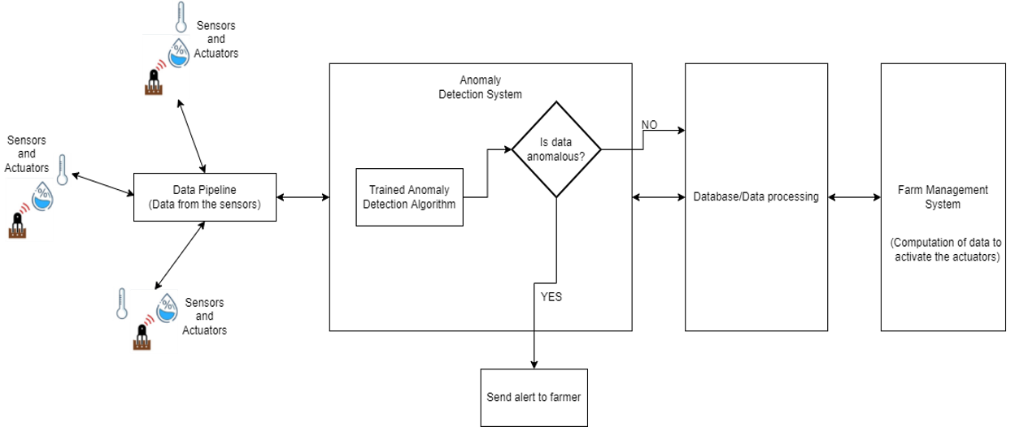
PROPOSED Architecture

Slide 12
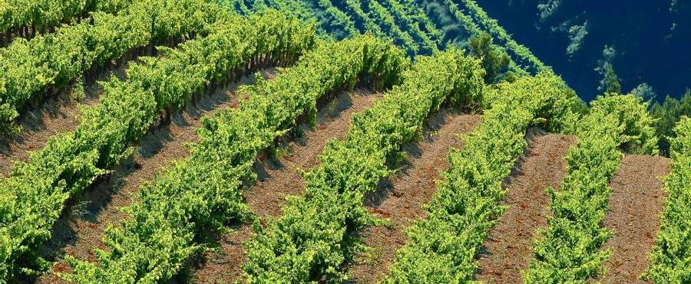
cONCLUSION
The population explosion will increase food consumption, but as arable land decreases, resources must be optimized.
With the help of sensors, actuators, and farm management systems, Agriculture 4.0 focuses on getting better yields by maximizing the resources available.
As farming systems expand into the digital age, there is a risk of cyberattacks from malicious parties and malfunctions causing system failures.
Data coming from sensors will be monitored to prevent malicious data forgeries or malfunctions. If the data is not right, the farmer will be notified.
The goal of our system is to contribute to the development of secure and robust agricultural systems based on sensors, by ensuring that anomalous data does not lower crop yield and cause financial losses.

Slide 13
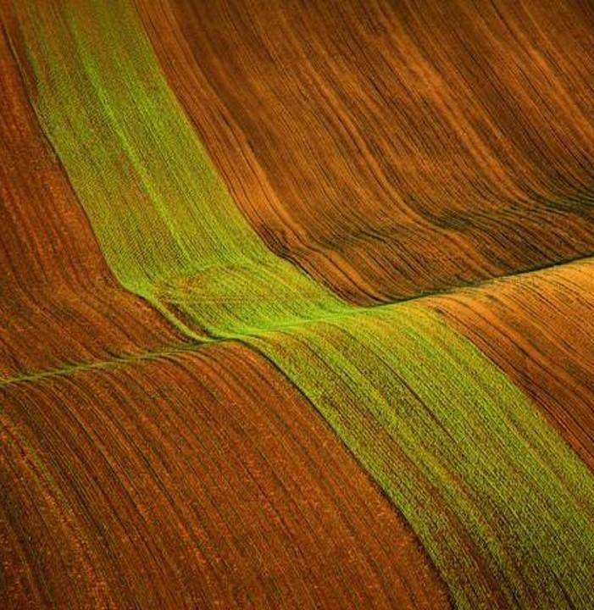
Thank you

